Slide 1
Pitch SingPay
Extension du réseau de paiement mobile SINGPay – Commerces de proximité et épargnes solidaires
Avril 2022

Slide 2
Sommaire
1-The vision………………………………………………………
2-The problem……………...…………………………………….
3- The solution……………………………………………………
4- Why now……………...…………………………………….…
5-Market size…………………………………………………….
6- The competition………………………………………………..
7- The product..……………….……………………………….…
8- The team…………………….………………………………...
9-The business model…….…………………………………….....
10- Financial tables……………………………………………....
11- OKR………………………………………………………….

Slide 3
1- La vision
Notre vision, est d’être un acteur à fort impact du progrès de l’inclusion financière en Afrique d’ici 2030

Slide 4
2- Le problème
L’apparition du mobile money a permis l’inclusion financière des milliers des gabonais. Le Gabon compte aujourd’hui 2,7 millions de comptes mobile money pour des transactions chiffrées à 624 millions de dollars par an soit une moyenne par habitant de 231 USD. Ces chiffres encourageants sont relativement bas en comparaison avec la moyenne africaine par habitant qui se situe à 4 267.
Exemple de frein à l’utilisation du M-Money
Ce constat peut-être expliqué par plusieurs facteurs représentant des freins à l’utilisation du mobile money:
Les transactions inter opérateurs mobiles restent encore complexes et peu utilisées
Les transactions ne sont pas perçues comme étant sécurisées
De nombreux commerces ne proposent pas le payement par mobile money
Plusieurs structures de collecte d’argent n’utilisent pas de solutions numériques
Beaucoup ne trouvent pas de valeur ajoutée dans le fait de payer par mobile money
Les solutions actuelles de payement ont un coût d’entrée dissuasif pour les PME et les startups
Les transactions inter-opérateurs mobiles restent encore complexes et peu utilisées
Dépenses moyennes annuelles par M-Money
Gabon
Afrique
231 $ / an
4267 $ / an

Slide 5
3- La solution
SING pay Commerce est une solution de fintech qui vient faciliter le paiement par mobile money grâce à un agrégateur et un intégrateur de paiement et ce avec un API standardisé, contrairement aux intégrateur actuel.

Slide 6
3- La solution
SING Pay Commerce, permet aux:
Individus
Commerces
Structures d’épargne
Gestionnaires des marchés
(Bar, boutique, pharmacie, petits commerces)
D’effectuer des transferts mobile money interopérable
De gérer les dépenses personnelles
De recevoir les payements des clients et fournisseurs
D’établir les factures et devis à partir d’un QR code
De collecter et de distribuer de l’épargne
(tontine, payement des stands de marché, micro épargne)

Slide 7
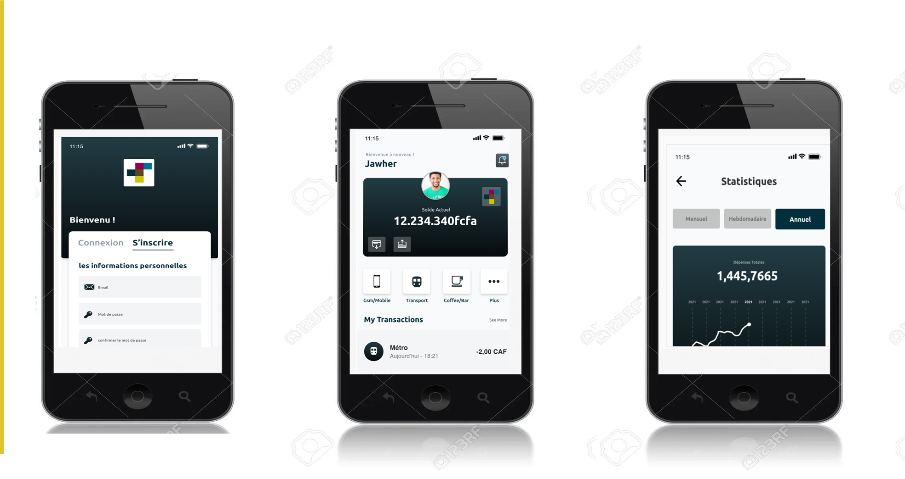
3- La solution
Une application simple d’utilisation qui permet :
De recevoir ou d’envoyer du mobile money quelque soit l’opérateur sans avoir besoin de me déplacer
De gérer ma tontine à distance
De gérer les collecteur d’épargne dans les marchés et de réaliser des paiements
De gérer mon budget personnel ou celui de mon commerce
Faire des factures et recevoir des paiements en 2 clicks grâce à un QR Code
Recharger les cartes prépayés de mes clients
Accepter des paiements de mobile money sur mon application
Faire des transactions visa et MasterCard à partir de mon téléphone
Inclusion et proximité grâce aux réseaux de clients utilisant les services financiers numérique SINGPAY
1

Slide 8
4- Pourquoi maintenant
Avec la pandémie du covid 19, il a rapidement été évident que la technologie mobile, et les services mobile money en particulier, auraient un rôle majeur à jouer pour maintenir le contact entre les personnes, leur permettre de recevoir une aide financière vitale et leur offrir un moyen sûr et sans contact de régler leurs différents achats et paiement.
Avec plus de 1,2 milliard de comptes enregistrés et 300 millions de comptes actifs dans le monde en 2021, l’utilisation du mobile money est en plein essor ces dernières années et fait donc partie désormais des habitudes quotidiennes.
Enfin, avec les actions mis en place ces dernières années pour favoriser l’inclusion financière, le secteur de la téléphonie mobile possède la couverture et la capacité d’innovation nécessaires pour ce renforcement.

Slide 9
5- Taille du marché
Marché global
Marché potentiel
Marché captif
161 millions de comptes actifs en Afrique
39 millions de comptes actifs en Afrique subsaherienne
2,7 millions de comptes actifs au Gabon

Slide 10
6- La concurrence
Concurrents directs
PVIT, agrégateur de moyen de paiement porté par la startup Bocae. Elle démontre d’une expérience en côte d’ivoire et au Gabon.
DIGITECH, agrégateur de paiement mobile. Il développe également des services additionnels tel que la vente des cartes prépayés.
Les API fournis par ces agrégateurs sont souvent constitués de plusieurs module pour chaque moyen de paiement géré par l’intégrateur (agrégateur). Ce qui implique que le marchant est obligé de réaliser des mises à jour de sa plateforme à chaque fois qu’il souhaite prendre en compte un nouveau moyen de paiement de son intégrateur de départ.
Contrairement à ces concurrents, SingPay a développé un API standardisé qui s’adapte à chaque infrastrure.

Slide 11
6- La concurrence
Concurrents indirects
Les opérateurs de mobile money et les banques avec leurs service de paiement qu’ils offres aux marchands.

Slide 12
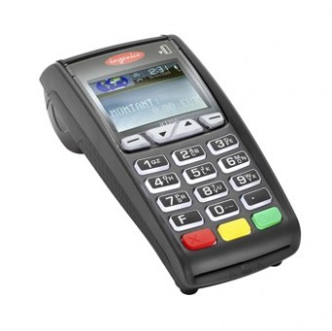
6- La concurrence
Solutions de substitution
Les services des opérateurs (TPE; Code Marchant; Cash; …)

Slide 13
7- Le produit
USE CASE
A. Costumer subscription journey
B.Shops subscription journey
A.1. Registration from the SingPay mobile App
B.1. Enrollment of shops by SING SA through SingPay backend
C. Payment transaction journey
D. Transfers transaction journey
C.1. Direct payment from the SingPay mobile application
D.1. Fund transfers from a recipient code
C.2. Business payment from the SingPay application
SCENARIO
A. Micro saving

Slide 14
7- Le produit
Macro journey
A. Costumer subscription journey
Micro journey
A.1 Sign up from the SingPay trader mobile application
Stages
Acquisition of the SingPay application
Registration
Search for « SingPay » on Google Play
Search for « SingPay » on Google Play
Intalling the app
Validation
Intalling the app
Opening the application on the terminal
Opening the application on the terminal
Filling in the registration form
Filling in the registration form
Costumer
Search for « SingPay » on Apple Store
Search for « SingPay » on Apple Store
An easy and intuitive registration procedure for users with very little education or accustomed to Digital
System action
Manual action

Slide 15
7- Le produit
Macro journey
B. Shops subscription trajet
Micro journey
B.1 Enrollment of shops by SING SA through SingPay backend
Stages
Prospecting
Registration
Account activation
Creation of user accounts to allow the shopekeeper to access their shop via the SingPay shop web platform
Sending account credentials by email
Open the email received by SingPay and click on the account activation button
Enter password (twice)
Validation
SHOPKEEPER
The opening of shop on the platform and allows you to accept payment for all your items by mobile money. The application allows you to track transactions precisely.
Trade registration on SingPay backend
SHOP
Target business meeting
System action
Manuel action

Slide 16
7- Le produit
Macro jourey
C. Payment transaction journey
Micro journey
C.1 Direct payment to a merchant from the SingPay mobile application
Stages
Choice if shop
Payment informations
Transaction processing on SingPay agregator
Credit/Debit
Search the trade on the SingPay mobile app
Enter the amount of the transaction
Choice of payment method
Enter payment identification
Notification
COSTUMER
Payment failed
Confirmation of payment
Payment is made directly on SINGPAY regardless of your operator or electronic payment provider (visa, paypal, etc.)
Successful payement
SHOP
Merchant Account Credit
System action
Manual action

Slide 17
7- Le produit
Macro journey
C. Payment transaction journey
Micro journey
C.2. Trade-to-merchant payment from SingPay mobile app
Stages
Generation of the QR code
Payment initialization
Transaction processing on SingPay Aggregator
Credit/Debit
Choice of payment method
Notification
Scan of the QR code present on the receipt from the SingPay mobile application
Enter payment identification
COSTUMER
Payment failed
Confirmation of payment
Successful payement
A QR to make payments in simplicity and security
Registration of the sale in the SingPay commerce web application
Click on the generate QR code button
SHOP
System action
Manual action
Crédit du compte du commerçant

Slide 18
7- Le produit
Macro journey
D. Transfer transaction journey
Micro journey
Fund transfer via a receiver code on the SingPay application
Stages
Server code creation
Payment initialization
Transaction processing on SingPay Aggregator
Credit/Debit
Choice of payment method
Electronic account credit
Creation of a receiver code by entering the information of the electronic reception account
Creation of a receiver code by entering the information of the electronic reception account
Creation of the transaction
Enter payment identification
Creation of the transaction
RECIPIENT
The transfer of mobile money between individuals regardless of your operator from your sofa will be possible on SINGPAY
Payment failed
Payment confirmation
Successful payment
Entering the receipt code and the amount of the transaction
SENDER
Notification
System action
Manual action

Slide 19
7- Le produit
SCENARIO
Microfinance
Actors
Uses of SinPay Shop in the business
Microfinance subscribes to a commerce subscription at SingPay
The saver subscribes to a customer subscription with SingPay Commerce
The saver can make direct payments to microfinance
Via the transaction history with pagination he can follow the payments of each page of his book
From the transaction history with pagination he can follow the payments of each page of his book
The salesperson continues to register savers by offering them a microfinance savings book
The salesperson no longer receives the money directly in cash, he just notes the validation of the payment in the physical book
Microfinance can check the reliability of notebook information by comparing with transaction pagination
The saver
The microfinance business
Manage your tontines, savings groups and other contributions from your phone
The microfinance

Slide 20
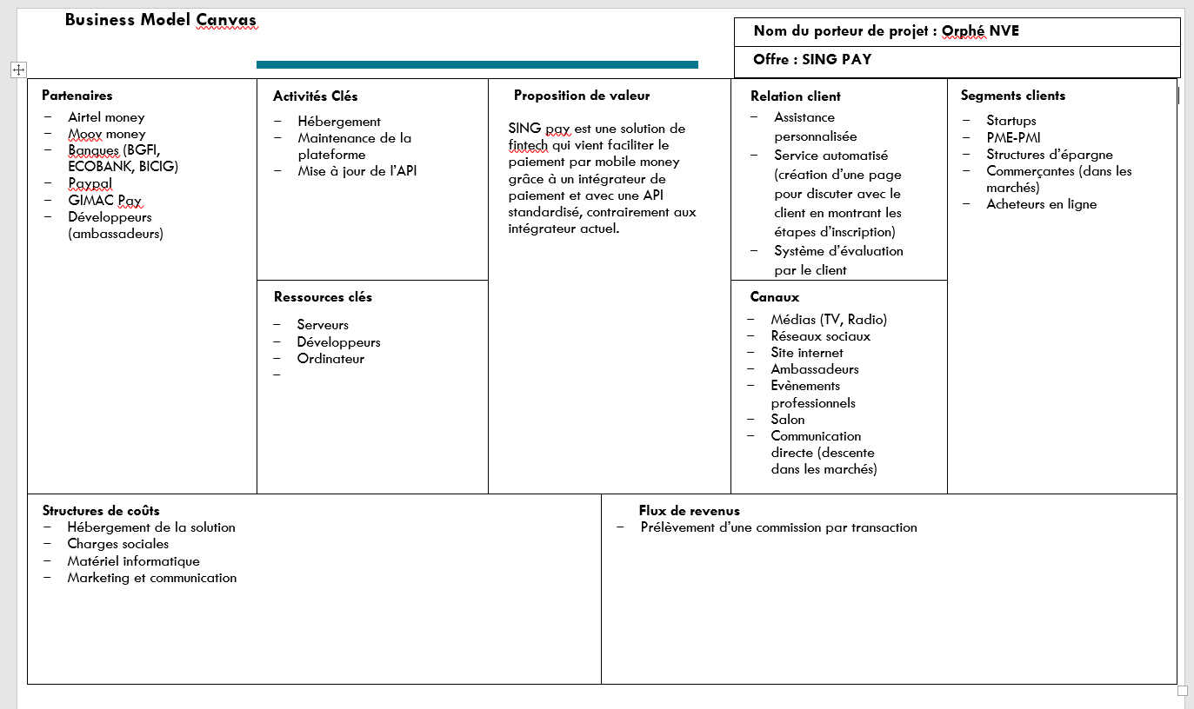
8- Le business model

Slide 21
9- L’équipe
Yannick EBIBIE
General Manager
Digital Incubation Company of Gabon
Expert in Incubation and startup strategy
specific experience
General Manager SING SA
Definition of the economic model
Development of incubation and acceleration programs
Development of partnerships
Constitution of the team and the offer
Expert in the implementation of incubation programs, in 2018 he piloted the creation and implementation of this first incubator completely dedicated to Digital in Gabon. By designing the programs and the organizational and operational master plan, he defined a strategy aimed at making the incubator financially autonomous from a unique economic model in the sub-region. . In 2014, he created the Entreprenarium programs, the first accelerator in the sub-region that offers philanthropic capital and acceleration programs based on the Lean startup methodology. More than 2,000 young people and women in Rwanda, Gabon, Côte d'Ivoire and Senegal will benefit from these programs. Several times rewarded in Entrepreneurship in the USA, he obtained in 2014 the Grand Prix de L'Excellence in his native country Gabon where he returned after having had a rich professional experience of more than 10 years in the United States and in France at managerial positions in the development of support programs for SMEs in difficulty in incubators and in the American administration
Administrator Entreprenarium (100% private incubator)
Establishment of a management center for Gabon and Rwanda
Training of supervisors of the incubation program of the University of Kigali
Implementation of resource mobilization strategies
Realization of implementation studies in Senegal, Ivory Coast and Rwanda
Development of the business plan
Director of Strategy and Marketing
Definition of the business process strategy of the Administrative Single Window
Management of start-up financing programs (CNPA, CAPE)
Development of terms of reference for the analysis of value chains in Gabon
Resource expert for the feasibility study for the establishment of a regional incubator
Senior Consultant – Performance Group
Structuring of the business processes of the PSGE Coordination Office
Development of technical notes for the National Industrialization Scheme
Establishment of a PSGE project bank (agriculture)
Professional career
Business Services Manager – City of Philadelphia Department of Commerce
Evaluation of public support policies for SMEs
Implementation of the monitoring system for business services
Management of the federal support program for the commercial revitalization of SMEs
15 years of experience
Digital Incubation Society of Gabon Entrepreneurarium (Incubator)
National Investment Promotion Agency of Gabon Performances Group (Advice and Management)
GFI Informatique - France
Philadelphia Economic Development Agency (PIDC)
Women Opportunity Business Center (WORC) – USA
Diplomas
Expert in Industrial
Engineering and Services – Ecole Centrale Paris
Master 2 Strategy and Entrepreneurship – J.Fox School Business (USA)
Languages
English (bilingual)
Skills Areas
31
Expert in entrepreneurship and support for SMEs
Expertise in business development and marketing Expertise in creating a business plan
Design of incubation programs
Expert in Lean Management
Strategy and development of innovative products and services

Slide 22
9- L’équipe
Postal Bank: Launch of a new account-keeping offer for PMO clients
Definition of the offer and the target underwriting and management processes
Attijariwafa Bank (Morocco): Definition of a programmed plan for the overhaul of the SME sector
Flash diagnosis of the existing organization and instruction of the transformation roadmap for the sector
Sogessur (Society General's non-life insurance subsidiary): Plans to distribute new IIARD insurance offers
Definition of distribution and management processes
Project management and coordination with the various teams (business lines, publisher, IT)
BNP Paribas CIB – Impact study of new anti-money laundering regulations
Scoping of the project and formalization of the impacts of FATCA and AEoI regulations on the "On-boarding" process
BNP Paribas CIB – Impact study of new anti-money laundering regulations
Scoping of the project and formalization of the impacts of FATCA and AEoI regulations on the "On-boarding" process
General Society BDDF / Credit du Nord: Transformation and convergence program between the two brands
Modelling and optimization of the start-up processes and distribution of offers for “retail” and “professional” markets
Project management
Society General Private Banking: implementation of a reference system for financial instruments as part of the deployment of a credit risk management solution
Drafting of detailed functional specifications
Coordination of work with different stakeholders
Specific experience
Aymen ZNAIDI
General Manager ADDINN
Digital transformation expert for 14 years.
Domaines de compétences
31

Slide 23
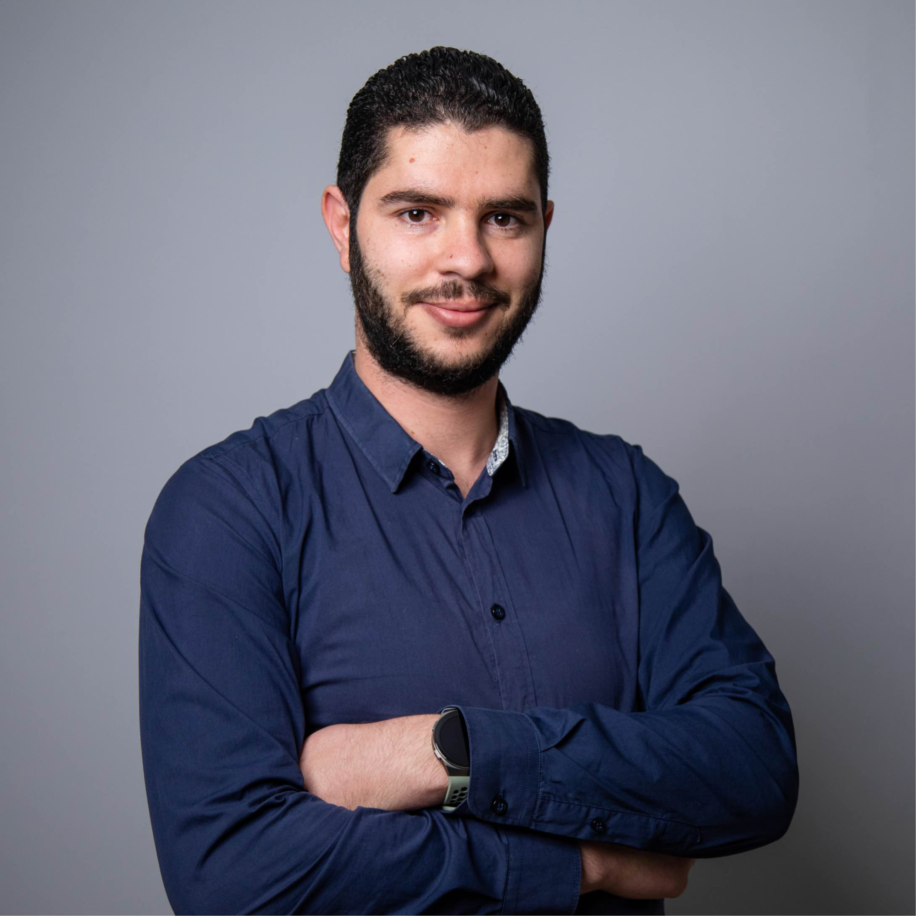
9- L’équipe
Expériences Spécifiques
Specific experience
Team Lead Mobile
Manage mobile resources
Manage mobile projects
US drafting with DMs
Validation of applications deliveries
Ensure quality of delivery
Ensure delivery deadlines are met
Synchronize between the different stakeholders on the projects
Support the design team for a better UX
Mohamed Sadok KRICHEN
Team Lead Mobile ADDINN‘s
Computer engineer, software engineering since 2016, specialized in mobile development, iOS.
iOS Developpeur
Mastering the iOS development environment
Mastering Swift languages with versions 3, 4 and 5
Knowledge of objC language
Mastering the UIkit framework
Mastering the Alamofire framework
Mastering Apple design guideline
Professional career
6 years experience
Addinn
Innovitech
Mobilite
Nomadecom
Multicom
Diplômes
Diplome national des ingénieurs
Langues
Français
Anglais
Skills areas
Project costing
Project Management
Writing of the US
Scrum master
Domaines de compétences
31

Slide 24
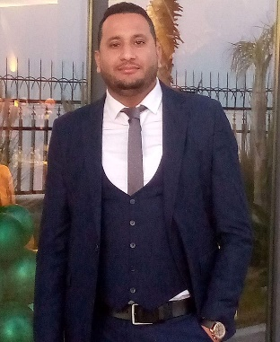
9- L’équipe
Specific experiences
Ahmed DARJDIDA
Scrum Master / QA
ADDINN Tunisia
Scum Master/ Quality Assurance Officer - Addinn Tunisia
Mastery of the different aspects of the Scrum methodology
Know how to organize the stages of a project, know the role of everyone in the team,
Ensure team efforts are focused to successfully complete their sprint
Check the compliance of the production processes with the standards and specifications,
Identify and diagnose malfunctions,
Propose relevant solutions
Petroleum Geology Engineer, he began his professional career in 2010 at Schlumberger Limited, a multinational oil services and equipment company, where he held the positions of a Mudlogging Analyst and a Data Analyst, oil and gas drilling projects in West Africa and Tunisia. He joined OilServ Oilfield Services Tunisia in 2015 as a Data Analyst.
Since the summer of 2020, he has joined the team of ADDINN Tunisia, an expert in digital transformation, where he first held the position of a BPO (Business Process Outsourcing) agent for a year. Now it is a Scrum Master and also responsible for quality assurance.
Mudlogging Analyst/ Data Analyst- Schlumberger Limited
Responsible for the effective management of the Mudlogging unit including personnel, equipment, supplies and maintenance
Provide high quality drilling and gas data
Ensure data integrity and reliability
Produce an end-of-drill report based on data collected during drilling operations
Maintenance of data acquisition equipment
Monitor interaction and communicate drilling parameters, to help prevent insecurity during drilling
Professional Career
Addinn Tunisie (Tunisia)
OilServ Oilfield Services Tunisia (Tunisia)
Schlumberger Limited (Worldwide Commuter)
Diplôme
National Engineering Diploma in Geo-Resources and environment
Languages
English - fluent
French - current
German - current
Arabic – mother tongue
Skills areas
Data analysis
Project management according to the "Scrum" Agile method
Oil & Gas Engineering
Geology, and geosciences
Domaines de compétences

Slide 25
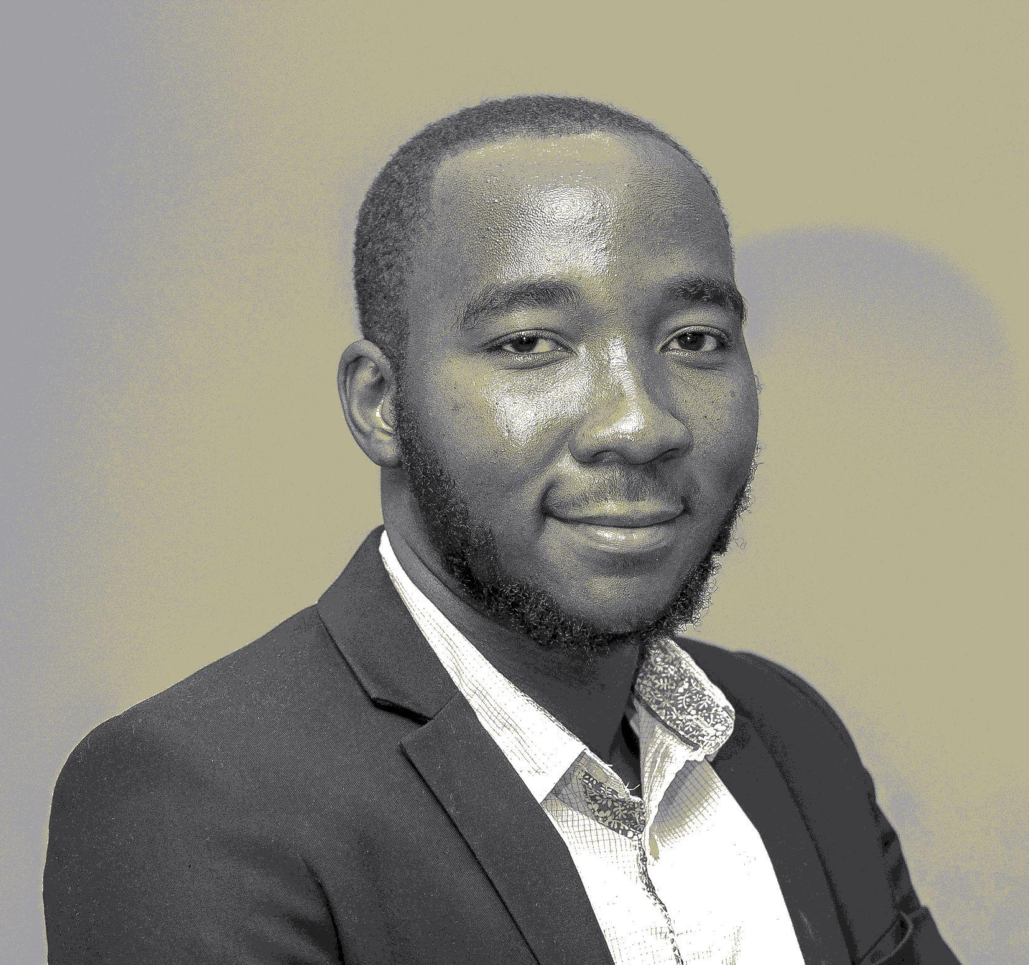
9- L’équipe
Specific Experience
Orphée NVE HOUNKPONOU
DevOps
Digital Incubation Company of Gabon
Web and mobile developer
Development of several applications for the digitization of the amicable report.
Development of the SingPay payment solution aggregator (NodeJS)
Development of the ePharma pharmacy management system
Development of the management system for the Ogasso restaurant chain (Web & Mobile)
Development of TestCovid, the national Covid-19 test management platform
Development of the mobile application for managing EDAN meters via the internet for Orema (Consultation of the balance and recharge), use of Mqtt to communicate with an IoT
Development of Gatax, a NodeJS web application, for easy tax management
Development of WebCars, android mobile application, solution of short-social carpooling
Development of the mobile adaptation of the Sincro solution
Development of a web platform (Angular, NodeJS, PostgreSQL) of extranet type for Total Marketing Gabon.
Development of an application to create a 3d map from a 2d map (Three.Js, HTML, CSS, JS, NodeJS).
Development of an application to help with waste management. (NodeJS) Development of several applications to help fight covid-19: Block covid19, self-test, covid-19 symptom, core-covid19.
Passionate about Programming for several years, he studied science at the University of Sciences and Techniques of Masuku where he obtained his engineering degree in networks and telecommunications engineering after a defense in which he obtained the mention very well following the presentation he had made of the digital tools for waste management that he had developed during his six (6) month internship.
Self-taught, during his university career he participated in several programming competitions during which he was distinguished.
For more than 1 year he has been part of the SING team as a web, mobile and IoT application developer. Or it participates in increasing turnover by developing solutions for companies such as Total Marketing Gabon, European startups such as Sincro and the Gabonese government. In addition, he supports startups in the realization of their vision by developing digital solutions adapted to their value proposition and by providing them with his expertise in agile project management, the notions of clean architecture and clean code to which he attaches great importance. importance.
A DevOps supporter, he is involved in all stages of the software life cycle (planning; development; testing; deployment; monitoring; maintenance).
Since the start of the Covid-19 economic and health crisis, it has continued to develop applications to help fight this pandemic effectively.
Développement de jeux vidéos
Development of a java library allowing to easily create 2D video games and even in networks.
Development of topten, a serious game to teach children to do additions (HTML5, Javascript)
Boom-box development (HTML5, Javascript, NodeJS, Socket.IO)
Development of On sea, winner of the largest hackathon in the world Space App Challenge 2019 in Gabon.
Development of “dada”, a multiplayer and network checkers game (Java EE, Socket)
Development of “BooglyAdventure”, a Mario Bros-like platform game, for the first edition of the Masuku Polytechnic School programming contest (C#, SFML).
Autre
Development in java and C++ of Surya, a cyber cafe management application with remote control of workstations as well as accounting.
Development of Nous Contribuons, an application to manage contributions.
Development of Schoolada: An application to help students organize themselves to learn better and thus progress
Consultant for Addin as part of a project with the Gabonese Transport Company (Technical Assistant).
Professional career
Skills areas
Web development: javascript, NodeJs, HTML, CSS, Angular, C#
Mobile development: Flutter, Kotlin, Java,
DevOps: CI/CD, Docker, Jenkins Git, Github, Gitlab
Database: MySQL, PostgresQL, MongoDB, Redis, Elastic Search Video
Game development: OpenGL, Godot, C/C++, C#, SFML, SDL, HTML5 (with Phaser), Three.JS
Agile project management: Scrum, XP, own architecture
Computer networks
Telecommunications
Administration system: Linux
3 years of professional experience
Developer, NGO We Need
Web and mobile developer, SING SA
Diplomas
Network and Telecommunications Engineer, Polytechnic School of Masuku
Languages
French
31

Slide 26
9- L’équipe
Specific Experience
Business Analyst
Dora-Liz KOUMBA NGOMA
Business Analyst
Digital Incubation Company of Gabon
Design of monitoring tools for startups
Support for the development of the development strategy of startups
Writing startup assessment reports
Drafting of SING activity reports
Training of young people on initiation to entrepreneurship Development of business cases
Billing support Disbursement follow-up
Customers feedback
Training follow-up
Maintaining the relationship with customers
Writing training content
A graduate in entrepreneurship and project management, she began her real professional career in 2018 at the Gabon digital incubation company, where she supported around fifty startups on a daily basis in the process of developing their projects. Having participated in several project competitions, she was able to obtain second prize in the business plan competition organized by the Société Equatoriale des Mines.
Commercial Support Korum Services
Preparation of invoices and quotes
Customer negotiation
Prospecting
Others experiences
Parcours career
Skills areas
4 years of experience
Digital Incubation Society of Gabon
Korum Services
Diplomas
Bachelor's degree in entrepreneurship and project management (AFRAM)
Master 2 Financial Engineering (AFRAM)
Languages
French
English (basic)
Financial evaluation of projects
Project management
Drafting of activity reports
Realization of statistics
Development of training content
Domaines de compétences
31

Slide 27
9- L’équipe
Madlyne Audrey MIKALA
Business Analyst
Digital Incubation Company of Gabon
Master II in project management
Expérience Spécifique
Business Analyst (SING)
Elaboration of essential tools for project monitoring
Elaboration of weekly project monitoring reports
Support for the financial preparation of the business plan
Support to the development strategy of the projects
Follow-up of the startups' disbursement plans
Support to startups prospecting
Follow-up of capacity building workshops for project leaders
Having a Master II in Project Management, certified in Monitoring and Evaluation of project, she was an intern at the firm (Sirasana consulting) of DAKAR in 2017 or she conducted project studies for project holders.In 2018, she is a Management Assistant at the firm (Asmy) specialized in Property Management, she was in charge of accounting and personnel management of the firm. During the same year, she was Marketing Manager at Horus Solution, an IT engineering firm. In 2021, she joined the Digital Incubation Company of Gabon (SING) where she supported the various startups of the Company's programs in the implementation and development of their projects. She is also an entrepreneur, she has a catering service. Translated with www.DeepL.com/Translator (free version)
Marketing Manger(Horus Solutions )
Elaboration of the marketing strategy
Prospecting activities
Prospecting reports
Maintenance of the customer relationship
Intern in charge of project studies at the firm(Sirasana consulting)
Professional career
Project design
Strategic planning
Operational planning
Economic analysis using the direct effects method
Analysis of project evaluation data
3 years of experience
Digital Incubation Company of Gabon
Horus solutions
MS Group (Cabinet Asmy)
Sirasana consulting firm in Dakar, Senegal
Diplomas
Master 2 in Project Management - Institute of Management of Dakar
Bachelor's degree in Finance - Accounting - Amadou Hampate Ba University of Dakar
Languages
French
Others experiences
31
Real Estate Management
Accounting
Business plan design
1

Slide 28
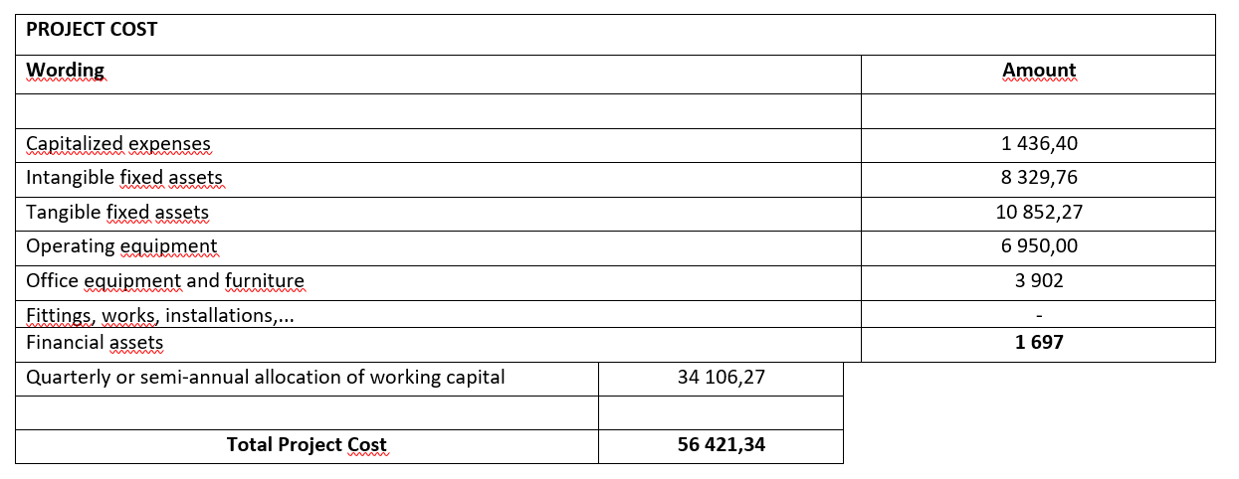
10- Les états financiers
Cost of the project (in USD)

Slide 29
10- Les états financiers
Estimated turnover over 3 years (in USD)

Slide 30
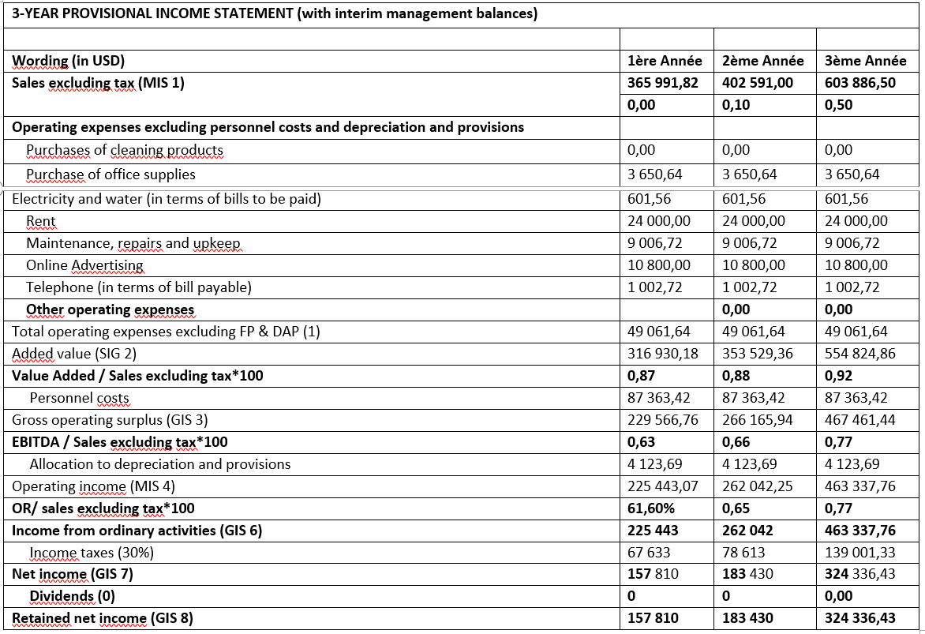
10- Les états financiers
3-year forecasted income statement (in USD)
1

Slide 31
11- OKR
Les objectifs à court et moyen terme
Développer la V1 de SingPay commerce (Android et IOS)
Intégrer SingPay dans des solutions de paiement supplémentaires (Ecobank Pay, Mobi Cash, PayPal, Bicig Mobile)
Développer la version web de SingPay pour les commerces
Enrôler les commerces du site pilote
Déployer de la V1 dans les commerces du site pilote

